Slide 2
learn what is hadoop partitioner.
learn what is the need of partitioner in hadoop
learn what is the default partitioner in mapreduce,
learn how many mapreduce partitioner are used in hadoop?
learn what is mapreduce combiner

Slide 3
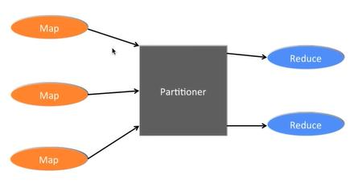
Introduction

Slide 4
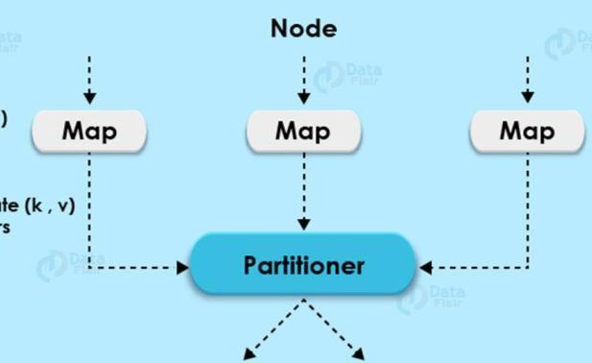
What is Hadoop Partitioner
Controls the partitioning of the keys
Keys derive the partition
Total number of partitions == Number of reduce tasks
It runs on the same machine
Entire mapper output sent to partitioner.

Slide 5
What is Hadoop Partitioner
Controls the partitioning of the keys
Keys derive the partition
Total number of partitions == Number of reduce tasks
It runs on the same machine
Entire mapper output sent to partitioner.

Slide 6
What is Hadoop Partitioner
Controls the partitioning of the keys
Keys derive the partition
Total number of partitions == Number of reduce tasks
It runs on the same machine
Entire mapper output sent to partitioner.

Slide 7
What is Hadoop Partitioner
Controls the partitioning of the keys
Keys derive the partition
Total number of partitions == Number of reduce tasks
It runs on the same machine
Entire mapper output sent to partitioner.

Slide 8
What is Hadoop Partitioner
Controls the partitioning of the keys
Keys derive the partition
Total number of partitions == Number of reduce tasks
It runs on the same machine
Entire mapper output sent to partitioner.

Slide 9
What is Hadoop Partitioner.
By default. Hadoop framework is hash based partitioner.
Hash partitioner partitions the key space by using the hash code.

Slide 10
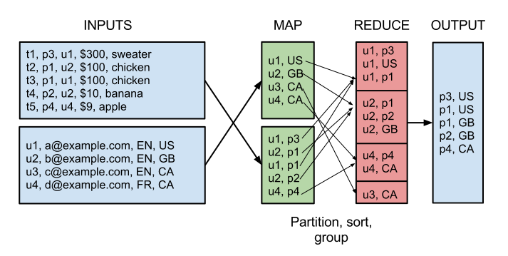
What is Hadoop Partitioner.

Slide 11
What is Hadoop Partitioner.
Which partition a given (key, value) pair will go ?
Key,value pair
Example (u1,US) (u2,GB) (u3,CA) (u4,CA)……….

Slide 12
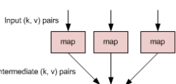
What is Hadoop Partitioner.
Data flow takes place after map phase

Slide 13
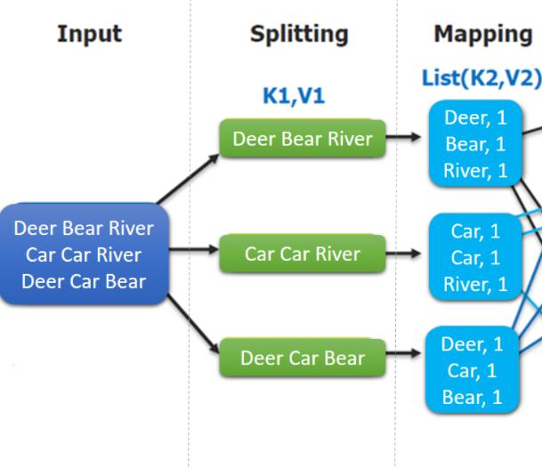
Need of MapReduce Partitioner in Hadoop

Slide 14
Need of MapReduce Partitioner in Hadoop

Slide 15
Need of MapReduce Partitioner in Hadoop

Slide 16
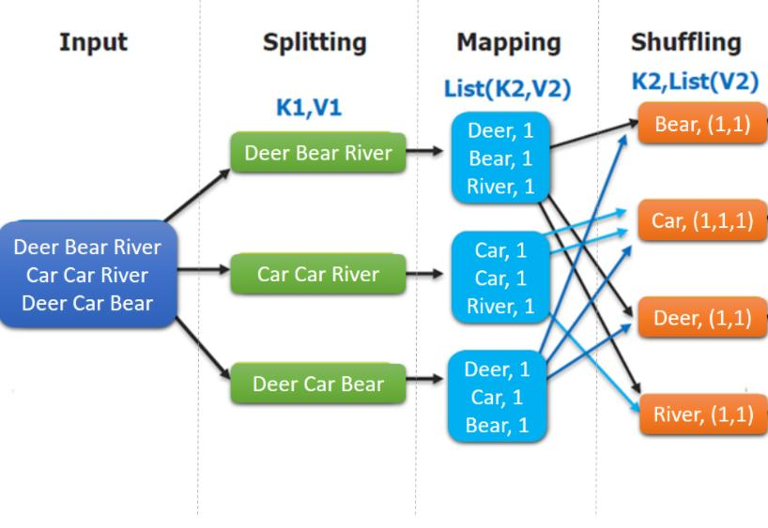
Need of MapReduce Partitioner in Hadoop
Map Output in a list of (key,value) in the intermediate file

Slide 17
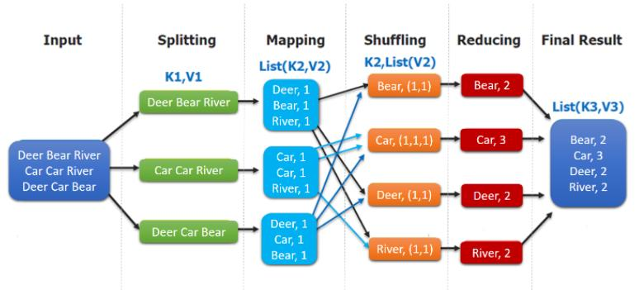
Need of MapReduce Partitioner in Hadoop
It also makes sure that all the values of a single key go to the same reducer.
Ouput in a list of (Key, List of Values) in the intermediate file

Slide 18

Need of MapReduce Partitioner in Hadoop
Partitioner makes sure that same key goes to the same reducer!

Slide 19
Hadoop Default Partitioner
Hash Partitioner is the default Partitioner.
It computes a hash value for the key.
It also assigns the partition based on this result.

Slide 20
How many Partitioner in Hadoop?
Depends on the number of reducers.
Partitioner divides the data.
It is set by JobConf.setNumReduceTasks() method.
Single reducer processes the data.
Framework creates partitioner only when there are many reducers.

Slide 21
Poor Partitioning in Hadoop MapReduce
If in data input in MapReduce job one key appears more than any other key.
The key appearing more number of times will be sent to one partition.

Slide 22
Poor Partitioning in Hadoop MapReduce
If in data input in MapReduce job one key appears more than any other key.
The key appearing more number of times will be sent to one partition.
All the other key will be sent to partitions on the basis of their hashCode().

Slide 23
Poor Partitioning in Hadoop MapReduce
If hashCode() method does not distribute other key data over the partition range.
Data will not be sent to the reducers.

Slide 24
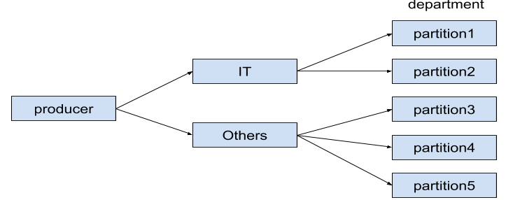
How to overcome poor partitioning in MapReduce?

Slide 25
Hadoop Combiner

Slide 26
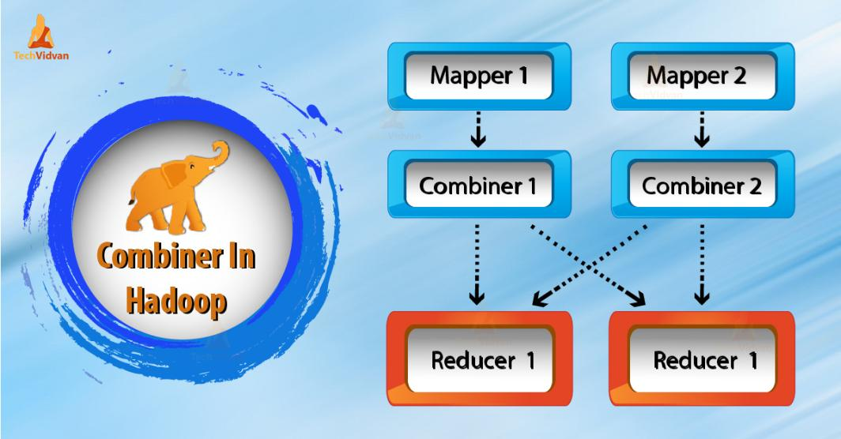
Introduction

Slide 27
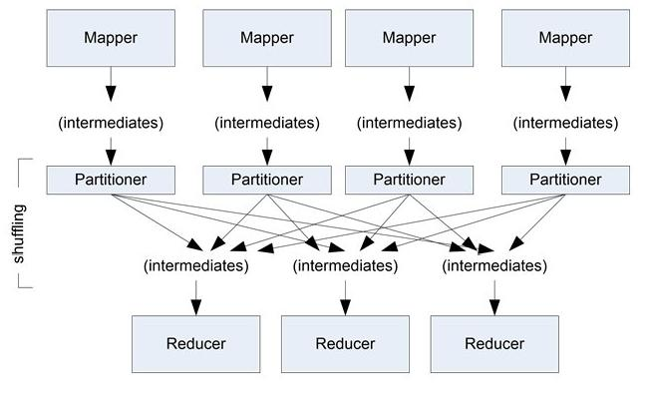
Hadoop Combiner
So Mapper generates large chunks of intermediate data.

Slide 28
Hadoop Combiner
So Mapper generates large chunks of intermediate data.

Slide 29

Hadoop Combiner
Network Congestion

Slide 30

Hadoop Combiner

Slide 31
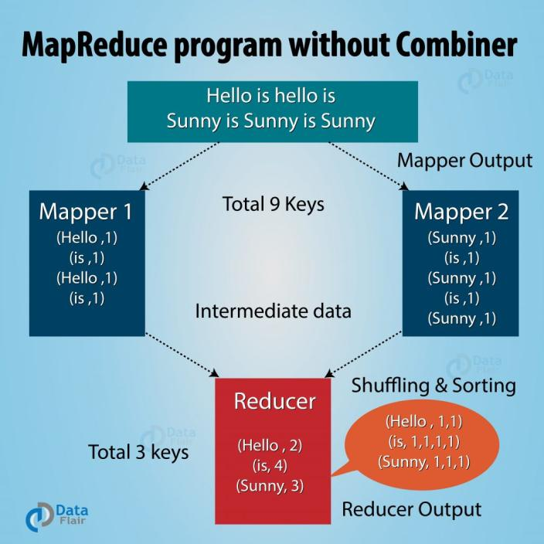
Hadoop Combiner
MapReduce program without Combiner

Slide 32
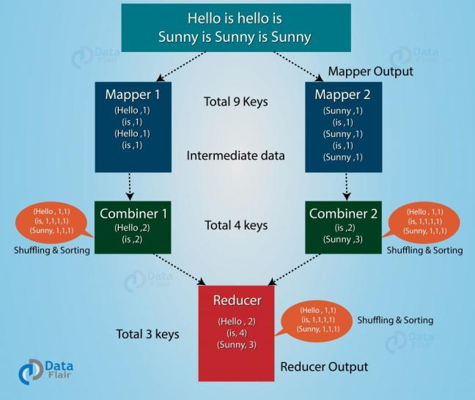
Hadoop Combiner
MapReduce program with Combiner in between Mapper and Reducer

Slide 33
References
https://data-flair.training/blogs/hadoop-combiner-tutorial/

Slide 34
Advantages of MapReduce Combiner
Reduces the time taken for data
Decreases the amount of data.
Improves the overall performance of the reducer.

Slide 35
Disadvantages of Hadoop combiner in MapReduce
There are also some disadvantages of hadoop Combiner. Let’s discuss them one by one-
MapReduce jobs cannot depend on the Hadoop combiner execution because there is no guarantee in its execution.
In the local filesystem, the key-value pairs are stored in the Hadoop and run the combiner later which will cause expensive disk IO

Slide 36
Disadvantages of Hadoop combiner in MapReduce
MapReduce jobs cannot depend on the Hadoop combiner execution.
Expensive disk IO

Slide 37
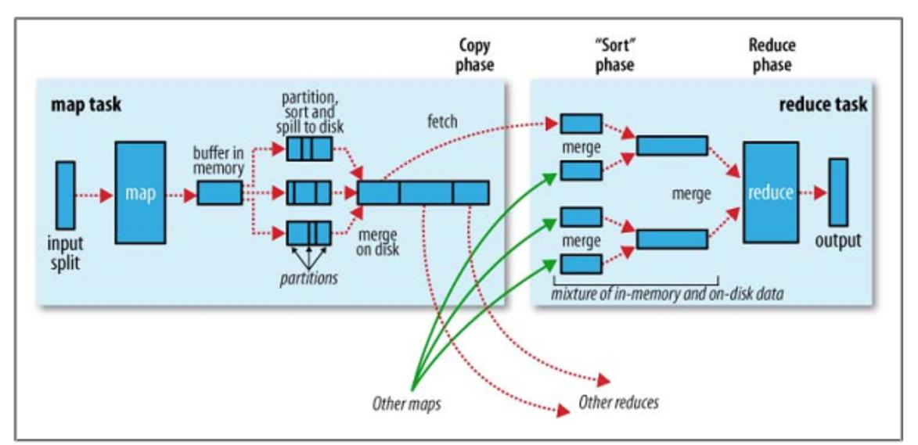
Shuffle and Sort in MapReduce

